Slide 1
Introduced Species

Slide 2
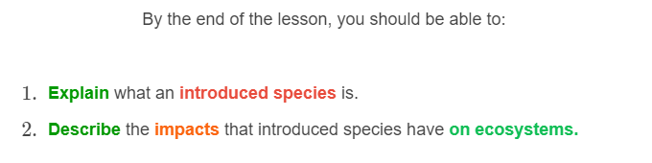
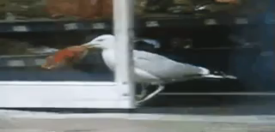

Slide 3

An introduced species is a species which has been released into an ecosystem where it does not occur naturally.
This can be deliberate or accidental.
An example of deliberate introduction of a species is rabbits, which were released in Australia for people to hunt.

Slide 4
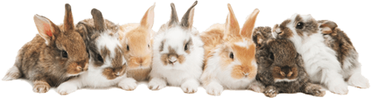
When Europeans first arrived in Australia, they brought rabbits with them to hunt.
Rabbits are originally from Europe and have many natural predators including foxes, badgers and stoats.
In Australia, rabbits had no natural predators.
This allowed rabbit populations to explode so quickly that no amount of hunting could reduce their numbers! Rabbits reduced food availability for other animals and destroyed native plant populations.

Slide 5


Slide 6
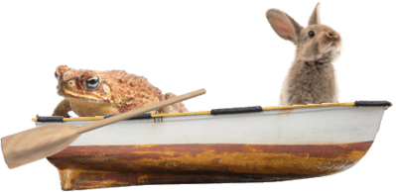
When an introduced species has few or no predators, it will breed rapidly, and increase its population size.
This can be a problem as they can take up space in an ecosystem that would usually belong to a native animal, potentially endangering native species.

Slide 7
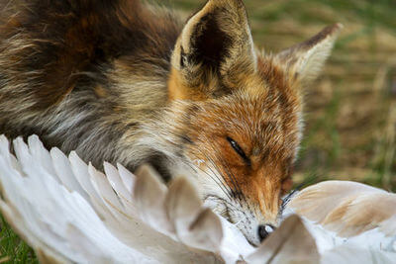
Introduced species create major disruptions within ecosystems.
This is because they can outcompete native animals for food and shelter, provide consumers with a new food source, or act as predators to a native animal.

Slide 8

Introduced species are a problem because they are introduced into ecosystems in which they do not belong.
They can have widespread and unpredictable effects on the native plants and animals.
Problems with introduced species have led to much tighter regulations on bringing plant or animal products into different countries.

